Slide 1
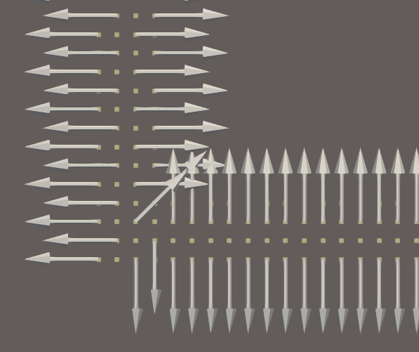
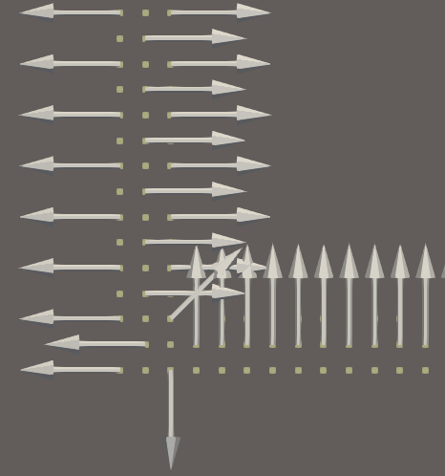
4 layers
3 layers

Slide 2












output_interval
output_interval
Output1
Output2
$$Δt_{ad}$$
$$Δt_{ad}$$
$$Δt_{ad}$$
$$Δt_{ad}$$
$$Δt_{ac}$$
$$Δt_{ac}$$
$$Δt_{ac}$$
$$Δt_{ac}$$
$$Δt_{ac}$$
$$Δt_{ac}$$
$$Δt_{ac}$$
$$Δt_{ac}$$

Slide 3
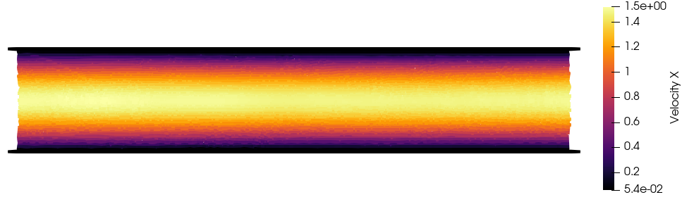
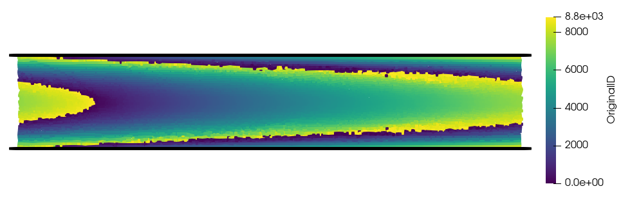

Slide 4
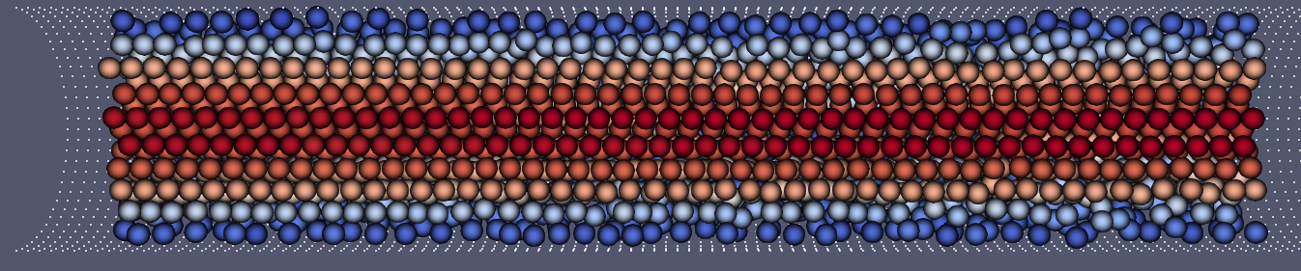
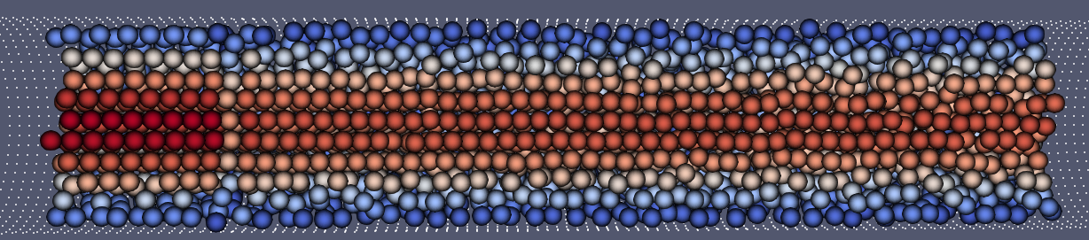
emitter_buffer_inflow_condition.exec()在最后
emitter_buffer_inflow_condition.exec()在中间

Slide 5
